Slide 1
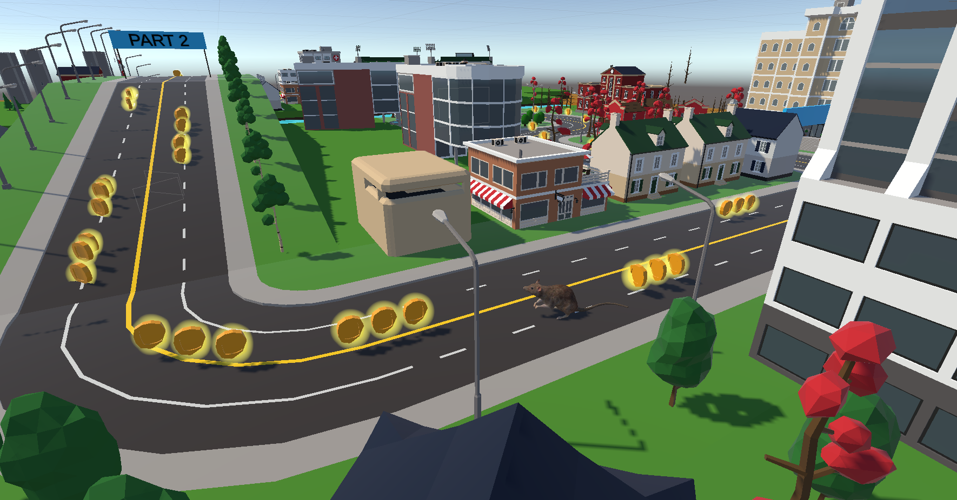
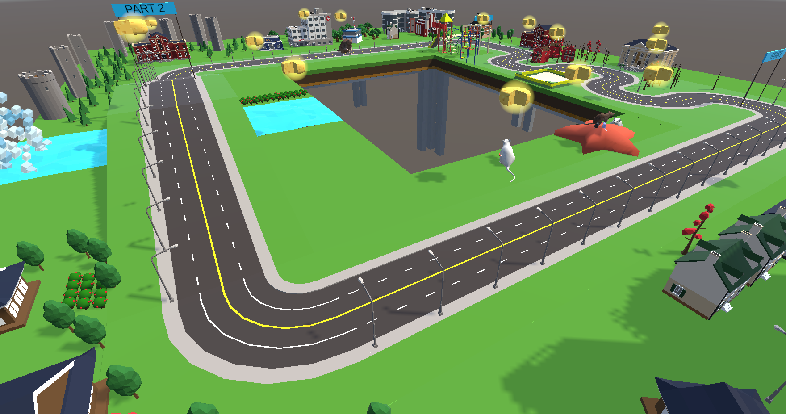
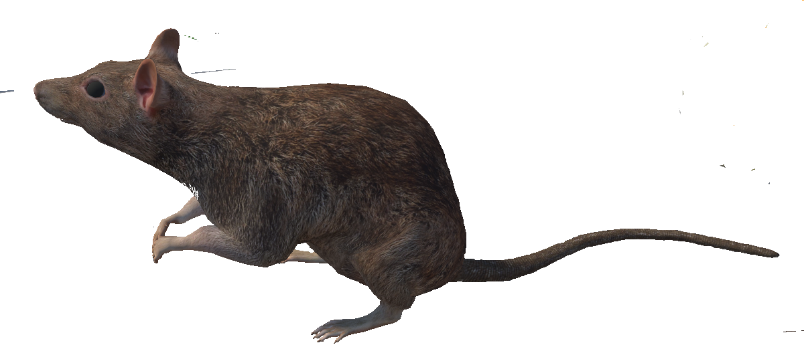
Getting used to rats
AR / VR Project

Slide 2
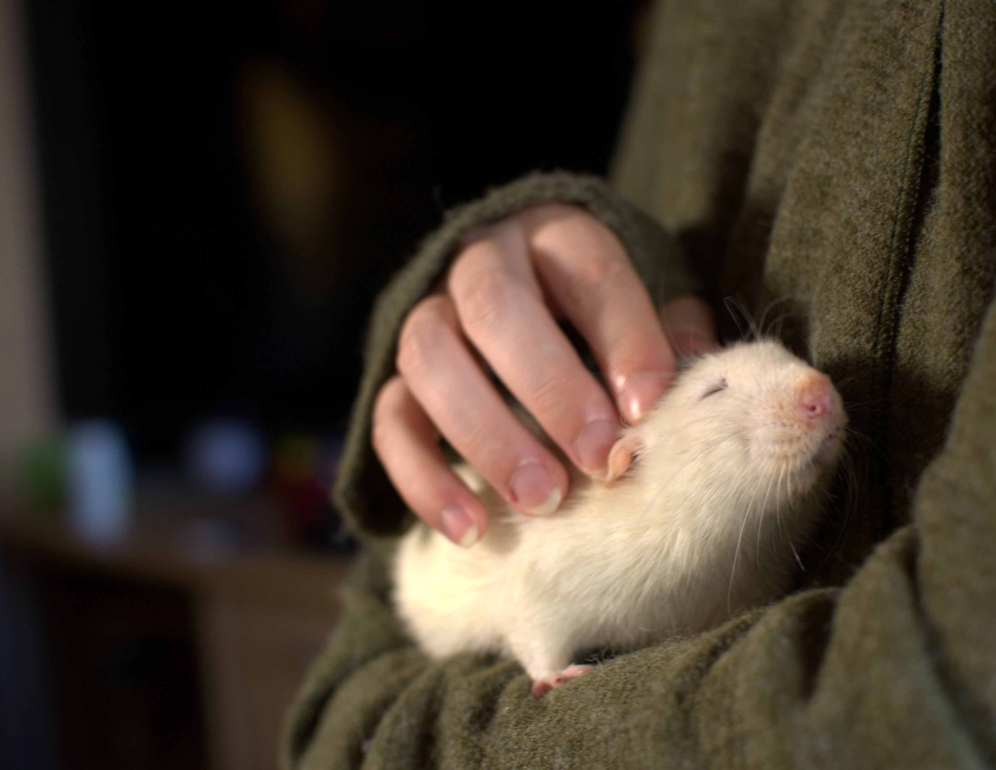
Motivation
Many people are afraid of rats
disgusting
unclean
scary
They are wrong
cute
smart
social
© Thomas Ott

Slide 3
Problem
We need to show them
No real rats
Interaction
Engagement
© Thomas Ott

Slide 4
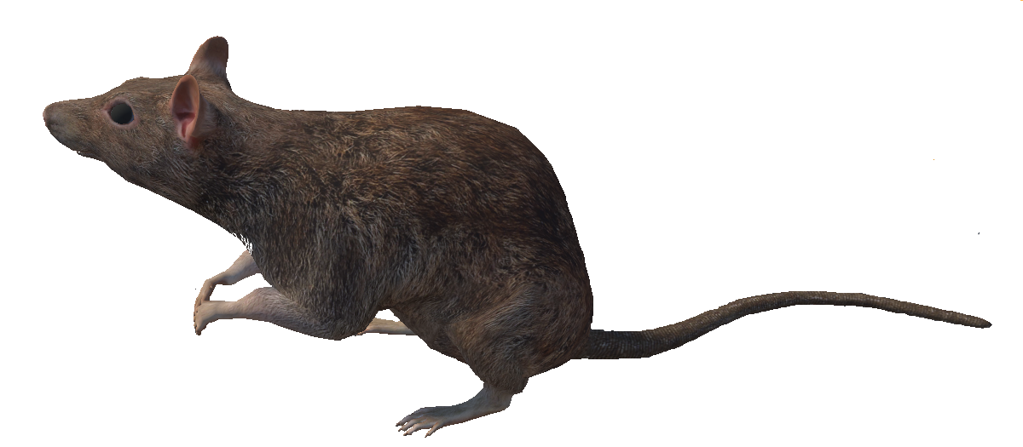
Solution
Let them interact with virtual rat
Make it look smart
Incorporate rat facts

Slide 5
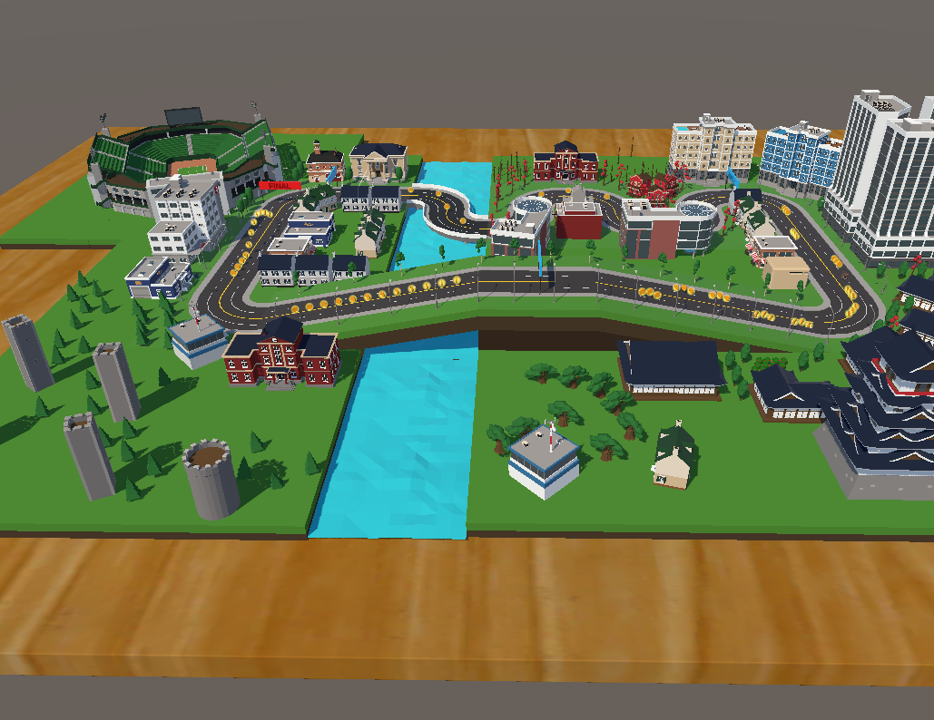
Details
Guide the rat with hand gestures
will seem smart
3rd person
no motion sickness
“real“ scenario
Seamlessly add factoids

Slide 6
ideas
something with rats?
learning scenario for DGS (Deutsche Gebärdensprache)?
Alice in wonderland scenario (shrinking, expanding)
-> Learning scenario with rats!
© Thomas Ott

Slide 7
Planned content
Must-haves:
complete parkour must be miniature-sized
the player controls a rat and leads it with gestures through the parkour
working gesture detection
ratfacts must appear somewhere in the game
pickup task: rat picks up the T with its mouth, player moves it with his gestures
scoreboard on a billboard in the parcour
Optional:
reset button while saving the gestures
comparing if gesture is too similar to another saved gesture
left hand support
gesture detection only works in front of the rat (line of sight)
different rats (baby, teeny, mid-age, old)
eastereggs
© Thomas Ott

Slide 8
Planned content
Must-haves:
complete parkour must be miniature-sized
the player controls a rat and leads it with gestures through the parkour
working gesture detection
ratfacts must appear somewhere in the game
pickup task: rat picks up the T with its mouth, player moves it with his gestures
scoreboard on a billboard in the parcour
Must-haves:
complete parkour must be miniature-sized
the player controls a rat and leads it with handposes through the parkour
working handpose detection
ratfacts must appear somewhere in the game
pickup task: rat picks up the T with its mouth, player moves it with his gestures
-> player moves cheese with his gesture, rat waits until the cheese has arrived
scoreboard on a billboard in the parcour
-> no scoreboard
© Thomas Ott

Slide 9
Planned content
Optional:
reset button while saving the gestures
comparing if gesture is too similar to another saved gesture
left hand support
gesture detection only works in front of the rat (line of sight)
different rats (baby, teeny, mid-age, old)
eastereggs
Optional:
reset button while saving the gestures
comparing if gesture is too similar to another saved gesture
left hand support
gesture detection only works in front of the rat (line of sight)
different rats (baby, teeny, mid-age, old)
Eastereggs
coins changed to cheese
rebuilt parcour (two times)
no points for grabbing the cheese, therefore one ratfact for one cheese
(gestures to json for the evaluation)
© Thomas Ott

Slide 10
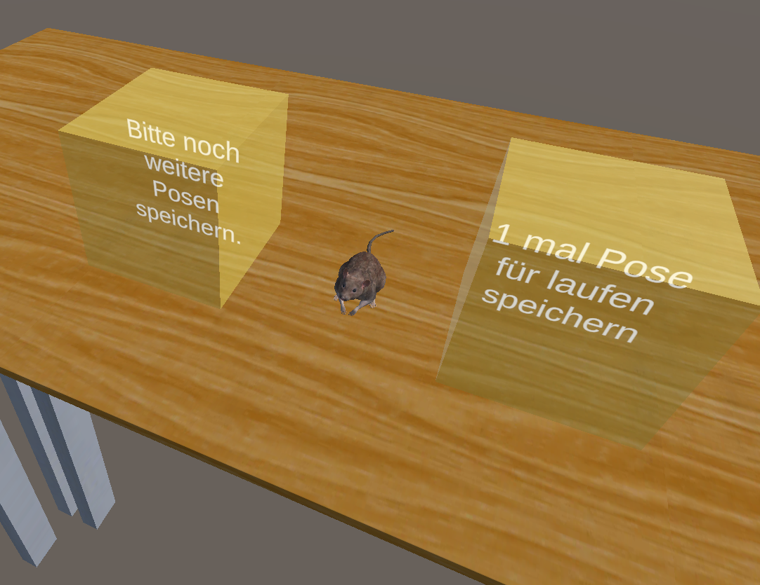
Learning scene
six handposes for guiding the rat:
walk forward
turn left
turn right
up
search
pick up
How?
put your right hand in the right box
start counter
after counter: gesture will be recorded

Slide 11
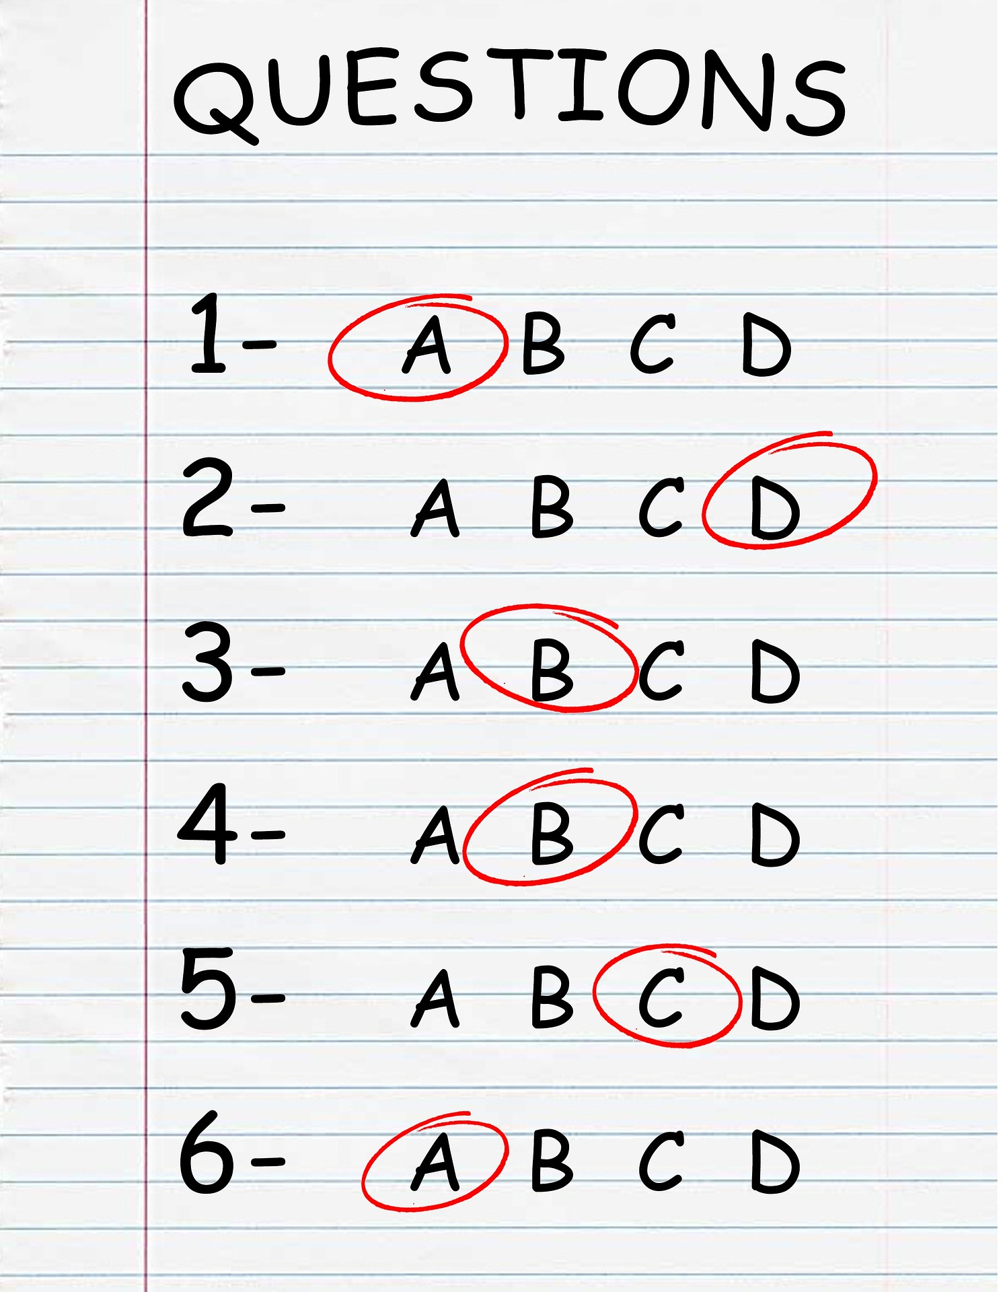
evaluation
Before and after the parcour:
quiz about rats
tracking which poses are used how often

Slide 12
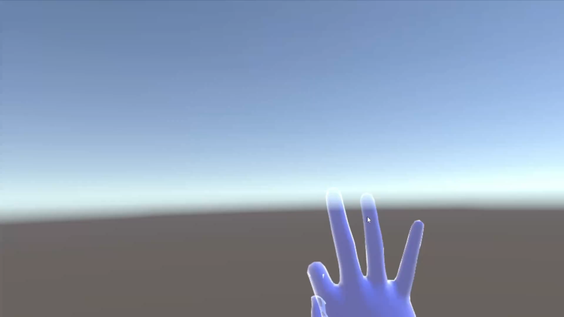
Preview

